Slide 1

AI-BASED CORAL HEALTH ASSESSMENT USING IMAGE CLASSIFICATION
PRESENTED BY
K.ASWINI(192312397)-ECE
M.SANDHYA(192312421)-ECE
M.INDUPRIYA(192372085)-CSE
COURSE NAME : ARTIFICIAL INTELLIGENCE
COURSE CODE:CSA1712
Guided by
Dr. Veeramani R

Slide 2


INTRODUCTION
Coral reefs are among the most diverse and valuable ecosystems on Earth, playing a crucial role in supporting marine life, protecting coastlines, and sustaining local economies. .
Monitoring coral health is therefore essential for conservation and timely intervention. Traditional methods of coral assessment are often time-consuming, expensive, and require expert knowledge.
To address these challenges, an image-based framework for identifying coral health states offers an efficient and scalable solution.
By using digital image processing and machine learning techniques, this framework analyzes visual features such as color, texture, and structural patterns to classify corals into categories like healthy, bleached, or diseased.
This approach enables faster, more accurate, and automated monitoring of coral reefs, contributing to better environmental management and preservation efforts.
Notes:
Image source: https://ae01.alicdn.com

Slide 3
OBJECTIVES
The main objective of this framework is to accurately classify coral health states (such as healthy, bleached, or diseased) using image-based analysis techniques).
This objective focuses on developing a system that can automatically analyze images of coral reefs and determine their health condition without relying entirely on human experts.
By achieving this objective, the system helps in early detection of coral damage, reduces manual effort, and enables large-scale monitoring of marine ecosystems. This is especially important for taking timely conservation actions, protecting biodiversity, and maintaining the ecological balance of ocean environments.

Slide 4
PROBLEM STATEMENT
Coral reefs are rapidly degrading due to environmental stressors such as rising sea temperatures, pollution, and ocean acidification.
Detecting changes in coral health at an early stage is critical for effective conservation; however, traditional monitoring methods rely heavily on manual inspection by experts, which is time-consuming, costly, and not scalable for large reef areas. Additionally, visual assessment can be subjective and prone to human error.
Therefore, there is a need for an automated, accurate, and efficient system that can analyze coral images and identify their health status.
Notes:
Image source: https://www.build-electronic-circuits.com

Slide 5
EXISTING SYSTEM
Currently, coral health monitoring is mainly done using manual and traditional survey methods. Marine experts and divers physically visit reef locations to observe and record coral conditions.
They capture underwater photographs or videos and later analyze them visually to identify whether the coral is healthy, bleached, or affected by disease. In some cases, basic image processing techniques are used, such as simple color thresholding or segmentation, to highlight changes in coral appearance.
Due to these challenges, existing methods are not efficient for large-scale, real-time monitoring, which creates the need for more advanced and automated approaches.
Notes:
Image source: https://www.slidemake.com

Slide 6
PROPOSED SYSTEM
The proposed method uses image processing and machine learning to automatically identify coral health from underwater images.
First, the images are cleaned and enhanced to remove noise and correct color. Then, important features like color and texture are extracted.
These features are given to a model (such as a CNN) that classifies the coral as healthy, bleached, or diseased. This method is faster, more accurate, and reduces manual effort compared to traditional approaches.
Notes:
Image source: https://teachingwriting.stanford.edu

Slide 7
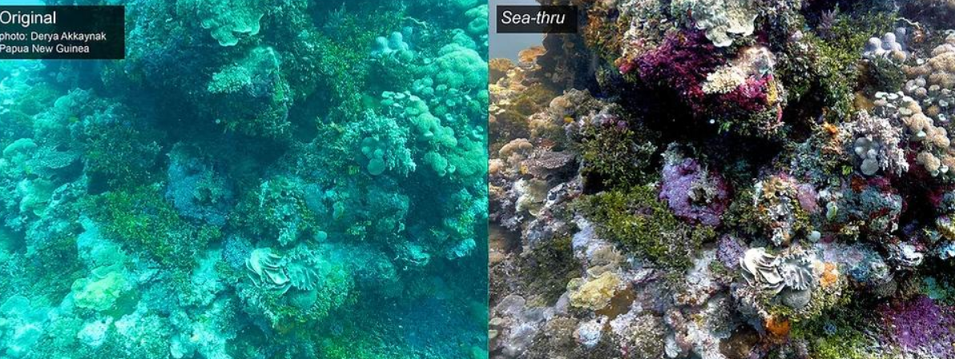
MODULE 1
Data Acquisition & Preprocessing
Flow:
Coral Image → Resize & Normalize → Clean Image
Example: A coral reef photo is captured and cleaned to remove noise and improve clarity.

Slide 8
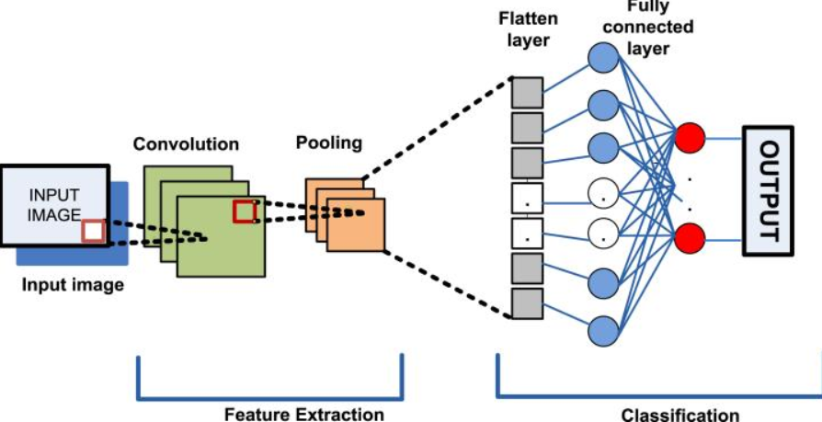
MODULE 2
Feature Extraction & Classification (CNN)
Flow:
Processed Image → Feature Extraction → CNN Model → Class Prediction
Example: The model detects color/texture and identifies if coral is bleached or healthy.

Slide 9
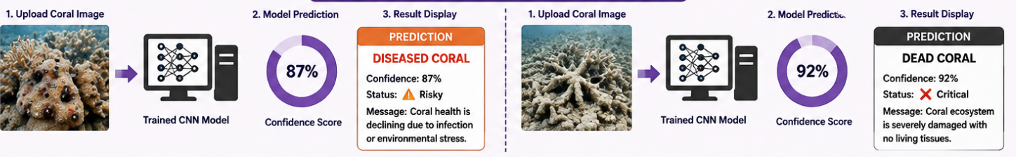
MODULE 3 Prediction & Result Display
Flow:
Input Image → Model Output → Prediction + Confidence → Display Result
Example Output:
Bleached Coral | 89% | Status: Warning

Slide 10
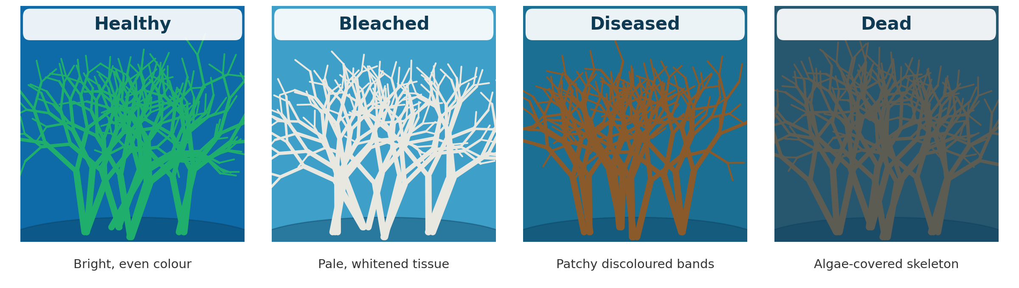
Coral Health States
Notes:
Image source: https://img.electronicdesign.com

Slide 11
DATA SET
S.No | Image | Healthy | Bleached | Diseased | Dead
1 | Coral Image 1 | ✔️ | ❌ | ❌ | ❌
2 | Coral Image 2 | ❌ | ✔️ | ❌ | ❌
3 | Coral Image 3 | ❌ | ❌ | ✔️ | ❌
4 | Coral Image 4 | ❌ | ❌ | ❌ | ✔️
5 | Coral Image 5 | ✔️ | ❌ | ❌ | ❌
6 | Coral Image 6 | ❌ | ✔️ | ❌ | ❌
7 | Coral Image 7 | ❌ | ❌ | ✔️ | ❌
8 | Coral Image 8 | ❌ | ❌ | ❌ | ✔️
Notes:
Image source: https://i1.wp.com

Slide 12
CODE
import numpy as np
import matplotlib.pyplot as plt
from tensorflow.keras.preprocessing import image
from google.colab import files
from PIL import Image
import random
# Step 1: Upload Image
uploaded = files.upload()
# Step 2: Load and Display Image
for fn in uploaded.keys():
img = Image.open(fn)
plt.imshow(img)
plt.axis('off')
plt.title("Uploaded Image")
plt.show()
# Step 4: Dummy Prediction (for demo purpose)
prediction = random.choice(classes)
confidence = round(random.uniform(85, 98), 2)
# Step 5: Map Status
if prediction == "Healthy":
status = "Good"
message = "Coral ecosystem is stable"
elif prediction == "Bleached":
status = "Warning"
message = "Coral is under environmental stress"
elif prediction == "Diseased":
status = "Risky"
message = "Coral health is declining"
else:
status = "Critical"
message = "Coral ecosystem is damaged"
# Step 6: Show Output
print("\n RESULT")
print("Prediction:", prediction)
print("Confidence:", confidence, "%")
print("Status:", status)
print("Message:", message)

Slide 13
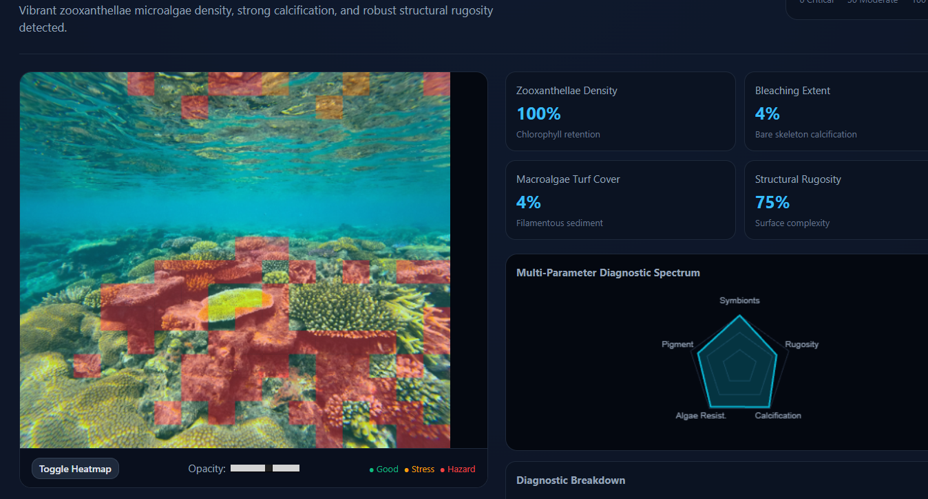
RESULTS

Slide 14
APPLICATIONS
Marine Ecosystem Monitoring:Detects early signs of bleaching or disease
Environmental Protection & Climate Studies:Useful for studying ocean temperature rise and pollution
Underwater Drone-Based Inspection:Enables real-time coral monitoring in deep oceans
Mobile App for Public Awareness:Users can click images and check coral health instantly
Tourism and Reef Management:Helps identify safe and healthy reefs for tourism
Research and Education:Helps students learn image processing and AI applications

Slide 15
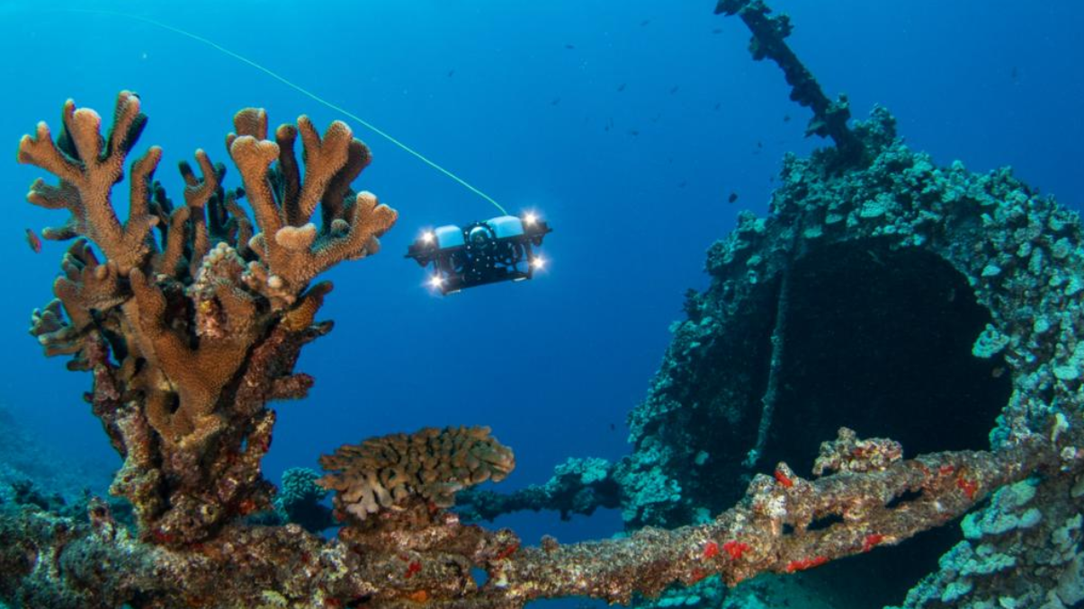
CHALLENGES AND FUTURE WORKS
Coral health detection from images faces challenges such as poor underwater image quality, similarity between coral conditions, limited datasets, and environmental variations that affect accuracy.
Additionally, high computational requirements make real-time use difficult. In future, these issues can be addressed by using advanced deep learning models, improving datasets, and developing real-time systems with drones or mobile applications, along with integrating sensors for better monitoring and more accurate results.

Slide 16
REFERENCES
Beijbom, O., Edmunds, P. J., Kline, D. I., Mitchell, B. G., & Kriegman, D. (2015). Towards automated annotation of benthic survey images: CoralNet.
Kaggle (2023). Coral Reef Image Datasets. Available at: https://www.kaggle.com
Digital Image Processing by Rafael C. Gonzalez and Richard E. Woods (Gonzalez, R. C., & Woods, R. E., 2018).
TensorFlow (Abadi, M. et al., 2016). TensorFlow: Large-Scale Machine Learning on Heterogeneous Systems.
OpenCV (Bradski, G., 2000). The OpenCV Library.
National Oceanic and Atmospheric Administration (NOAA) (NOAA, 2022). Coral Reef Conservation Program.
Great Barrier Reef Marine Park Authority (GBRMPA, 2021). Coral Reef Status Reports.

Slide 17
Thank you!!!

